Slide 1

DEPARTMENT OF COMPUTER SCIENCE AND ENGINEERING SCHOOL OF ENGINEERING AND TECHNOLOGY SRI PADMAVATI MAHILA VISVAVIDYALAYAM
AN ENSEMBLE LEARNING APPROACH FOR IMPROVED SLEEP DISORDER PREDICTION
Presented by
Peram Bhargavi
Guide: Co-Guide: G. Sreehitha, M. Tech.,(Ph.D) G. Radhika, M. Tech.,(Ph. D) Assistant Professor, Assistant Professor,
CSE, SOET, SPMVV CSE, SOET, SPMVV

Slide 2
Contents
Abstract
Introduction
Literature Survey
Existing System
Proposed System
Architecture
Module Description
Hardware and Software Requirements
UML Diagrams
Outputs
Conclusion
References

Slide 3
Abstract
Sleep disorders can harm both physical and mental health, but traditional diagnostic methods like Polysomnography (PSG) are costly, uncomfortable, and not easily available. The system collects user inputs such as age, occupation, sleep duration, caffeine intake, blood pressure, heart rate, BMI category, snoring frequency, working hours and health-related data to predict possible sleep disorders. This study aims to develop a more accessible and accurate method for detecting sleep disorders using machine learning techniques. Instead of relying on single models such as K-Nearest Neighbours (KNN), Support Vector Machine (SVM), and Random Forest. We combine multiple models using ensemble techniques like Stacking or Voting Classifiers. The system shows better performance in identifying sleep disorders. The model is integrated into a mobile application to provide a fast, cost-effective, and user-friendly tool for detecting sleep disorders. This approach offers a practical alternative to traditional tests and may help improve patient outcomes.
Keywords: Sleep Disorders, Machine Learning, Ensemble Learning, Voting Classifiers, Mobile Application.

Slide 4
Introduction
Sleep is essential for maintaining good physical health, mental stability, and daily performance, but traditional diagnostic methods like Polysomnography (PSG) are costly, uncomfortable, and not easily available. This makes diagnosis difficult, especially for people in rural or low-resource areas.
To address these challenges, this project uses machine learning to provide a simpler and more accessible method for identifying sleep disorders. By analysing basic health and lifestyle information, machine learning models can quickly predict whether a person is likely to have a disorder.
While individual models such as KNN, SVM and Random Forest provide good results, they often vary in accuracy and stability. Therefore, our project uses ensemble learning techniques—specifically Stacking or Voting Classifiers—which combine multiple models to produce more reliable and accurate predictions.
The system is enabling it to learn important patterns related to sleep health. To increase usability, the final model is integrated into a mobile application, allowing users to enter their data and receive instant predictions anytime, anywhere.

Slide 5
Literature Survey
[1] Muhammad Mostafa Monowar, S. M. Nuruzzaman Nobel , Maharin Afroj, “Advanced sleep disorder detection using multi-layered ensemble learning and advanced data balancing techniques”,2025.
The existing system aims to detect sleep disorders using single machine learning models, but their accuracy and stability vary and are not fully reliable. The major drawback is that the multi-layer ensemble model is computationally heavy, risks overfitting, and lacks external dataset validation, limiting real-world deployment and generalisation.
[2] MD Kamal Rasel, Taanzina Afroz Rimi, Mahmuda Rawnak Jahan, Shayla Sharmin “Improving Sleep Disorder Diagnosis Through Optimized Machine Learning Approaches”.
The biggest drawback of this study is that it uses a very small and limited dataset, which reduces the reliability and real-world accuracy of the models.

Slide 6
Cont..
[3] C. Tran, Y. Wijesuriya, R. Thuraisingham, A. Craig, & H. Nguyen, "Deep Learning for Classification of Sleep Stages," 2019.
This study focuses on the application of deep learning techniques for the classification of sleep stages using EEG data. The authors emphasize the potential of deep learning models to handle complex and high-dimensional sleep data, achieving high classification accuracy. Their approach demonstrates significant improvements over traditional methods, providing a strong foundation for applying deep learning in sleep disorder classification.
[4] E. Alickovic & A. Subasi, "Ensemble SVM Method for Automatic Sleep Stage Classification," IEEE Transactions on Instrumentation and Measurement, 2018.
This paper discusses the use of ensemble support vector machine (SVM) methods for automatic sleep stage classification. The authors address the challenges of accurately classifying sleep stages and demonstrate the effectiveness of ensemble methods in improving classification accuracy. Their findings highlight the potential of ensemble learning techniques in the field of sleep disorder diagnosis.

Slide 7
Cont..
[5] M. J. Sun, Z. F. Wu, & X. B. Lu, "Sleep Apnea Detection Based on Time and Frequency Domain Analysis of ECG and SpO2 Signals," 2020.
The authors propose a method for detecting sleep apnea using time and frequency domain analysis of ECG and SpO2 signals. By applying machine learning algorithms to these physiological signals, they achieve high accuracy in identifying sleep apnea events. This research underscores the importance of utilizing multiple data sources and advanced signal processing techniques for sleep disorder detection.
[6] T. Radha, V. S. Kumar, & S. Pradeep, "Classification of Sleep Disorders Using Machine Learning Algorithms," International Journal of Scientific Research in Computer Science, Engineering and Information Technology, 2019.
This study explores various machine learning algorithms for the classification of sleep disorders based on polysomnography (PSG) data. The authors compare the performance of different models, including decision trees, random forests, and neural networks, highlighting the advantages and limitations of each approach. Their results demonstrate the potential of machine learning in enhancing the accuracy and efficiency of sleep disorder diagnosis.

Slide 8
Existing System
The Existing System relies primarily on costly, complex, and time-consuming clinical procedures, most notably Polysomnography (PSG), conducted in specialised sleep laboratories. This traditional method requires extensive setup with sensors, overnight monitoring, and manual analysis by trained specialists. Additionally, earlier machine learning attempts often utilized only a single classifier (like SVM or KNN), which suffers from poor robustness and sensitivity to data imbalances, leading to inconsistent or unreliable predictions. Consequently, both the traditional clinical approach and limited single-model ML systems face severe issues with high cost, low scalability, and limited accessibility, preventing them from serving as effective tools for widespread public health screening. lack a user-friendly deployment mechanism like a mobile application, severely limiting public access and making it impractical for widespread public health screening.

Slide 9
Proposed System
The proposed system aims to provide a more accurate, accessible, and user-friendly solution for detecting sleep disorders using machine learning. Unlike traditional Polysomnography (PSG), which is expensive and inconvenient, this system uses ensemble learning techniques such as Stacking or Voting Classifiers to combine multiple predictive models, enhancing accuracy, stability, and interpretability. The system processes data as inputs from users, enabling it to detect various sleep disorders efficiently. It is integrated into a mobile application, allowing users to input personal details, track their sleep patterns, and receive instant reports on potential sleep issues. Additionally, the system supports physician interaction, enabling doctors to review the results and recommend treatments or lifestyle adjustments if necessary. By combining machine learning, wearable-compatible data collection, and mobile accessibility, the proposed system provides a fast, cost-effective, and practical alternative to traditional sleep diagnostics, improving early detection and patient care.

Slide 10
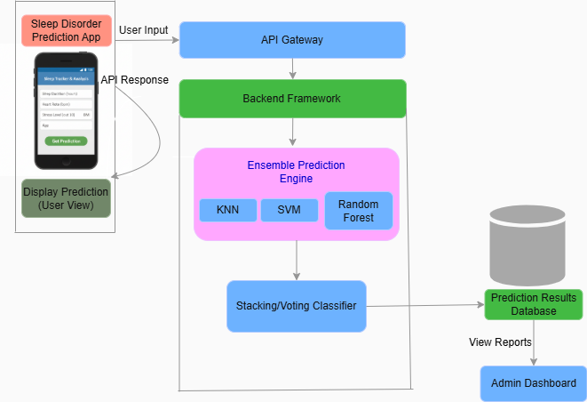
Architecture

Slide 11
Module Description
1. Client-Side (User View)
Sleep Disorder Prediction App: This is the frontend interface where users input their health data (Sleep Duration, Heart Rate, Stress Level, BMI, Age).
Display Prediction: Once the backend processes the data, this module shows the final results back to the user on their device.
2. Communication & Processing
API Gateway: Acts as the entry point that manages the "User Input" requests and routes them to the server logic.
Backend Framework: The core server environment (like Node.js/Express) that coordinates data flow between the gateway and the machine learning engine.
3. Ensemble Prediction Engine
Base Models (KNN, SVM, Random Forest): These three individual algorithms analyze the user data simultaneously to make their own independent predictions.
Stacking/Voting Classifier: This module combines the outputs from the three base models and applies a "voting" or "stacking" logic to determine the most accurate final prediction.
Prediction: The final output (e.g., Healthy, Insomnia, or Sleep Apnea) generated by the ensemble process.

Slide 12
Cont..
4. Data Storage & Management
Prediction Results Database: A central storage where all analysed reports are saved for future reference.
Admin Dashboard: A separate interface that pulls data from the database, allowing healthcare providers or administrators to view all patient reports and take action.

Slide 13
Hardware and Software Requirements
Hardware Requirements:
Processor - Intel Core i3
RAM - Minimum 8GB
Storage - Minimum 256 GB SSD
Mobile Device - Android Smartphone with a minimum of 2GB RAM, 50-100 MB
Storage
Software Requirements:
Operating System - Windows 11
Programming Language - Python 3.x,HTML,CSS,JavaScript
Libraries - NumPy, Pandas, Scikit-learn
IDE - VS Studio
Database - JSON
Deployment Platform - Render
Mobile Conversion Tool - AppsGeyser

Slide 14
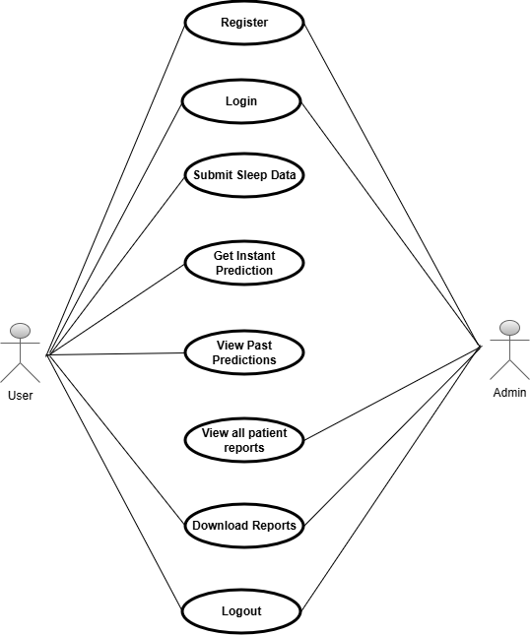
UML Diagrams
Use Case Diagram
Fig 1-Use Case Diagram

Slide 15
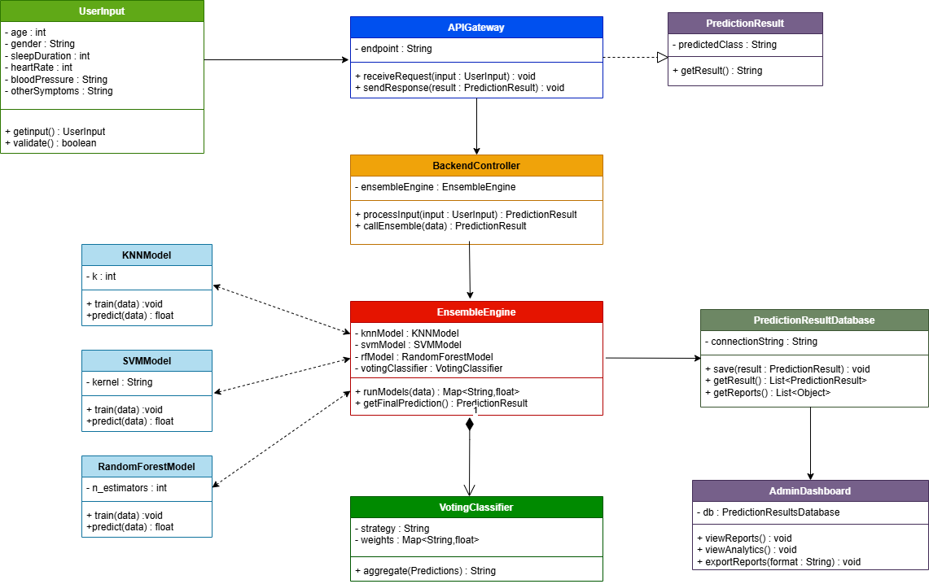
Class Diagram
Fig 2-Class Diagram

Slide 16
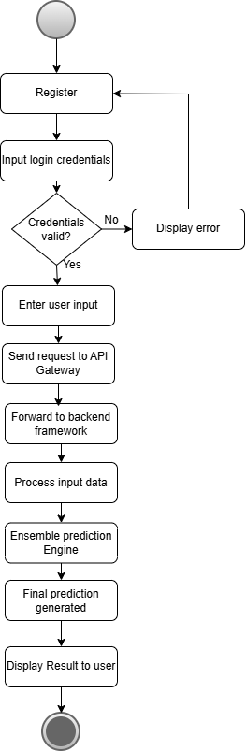
Activity Diagram
Fig 3-Activity Diagram

Slide 17
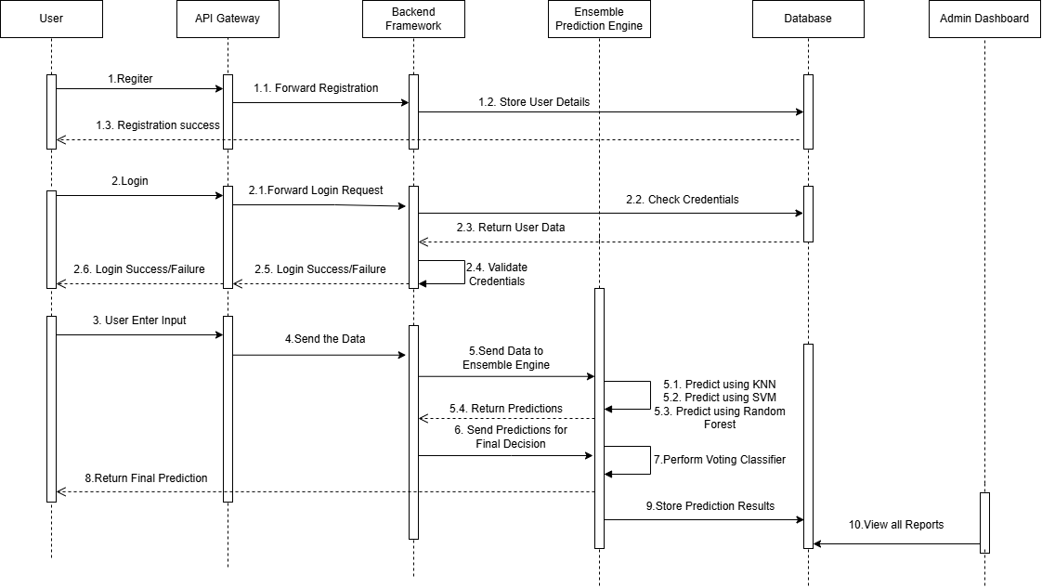
Sequence Diagram
Fig 4-Sequence Diagram

Slide 18
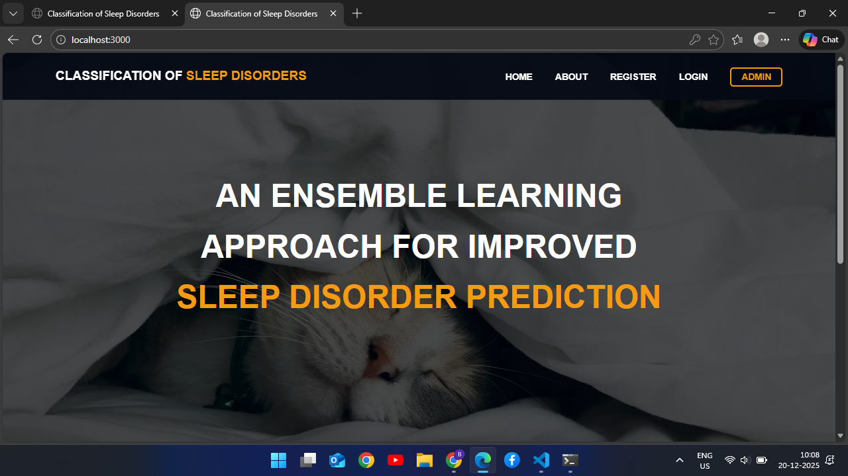
Outputs

Slide 19
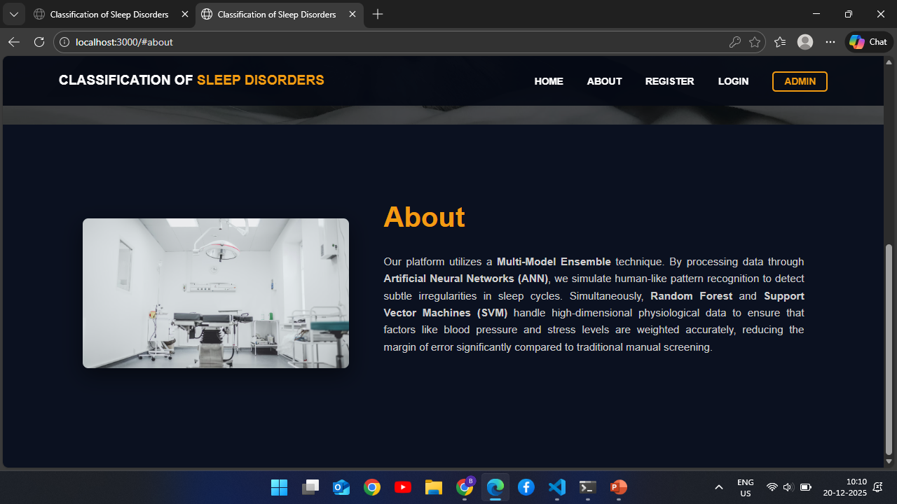

Slide 20
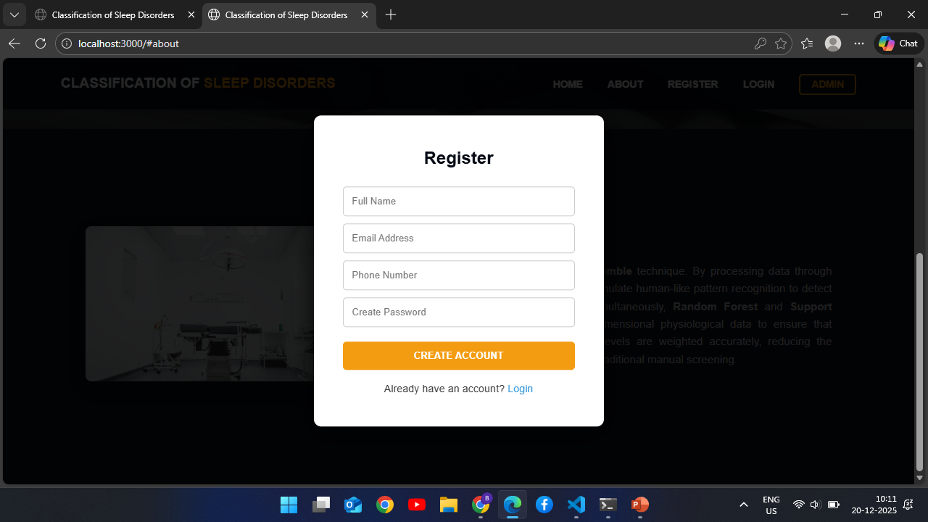

Slide 21
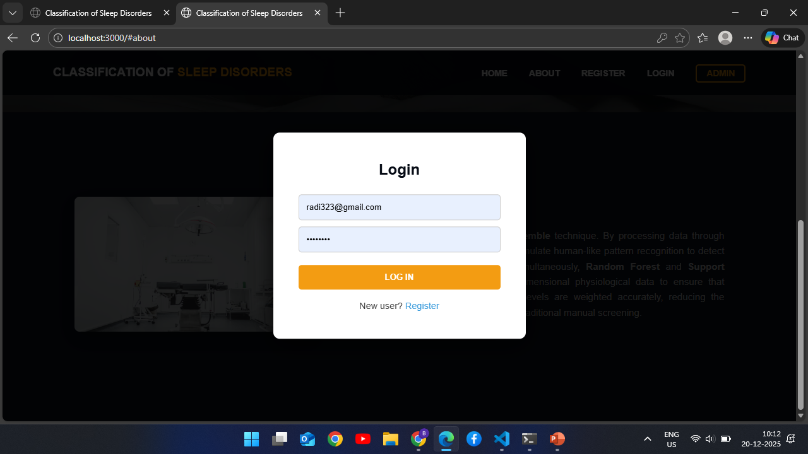

Slide 22
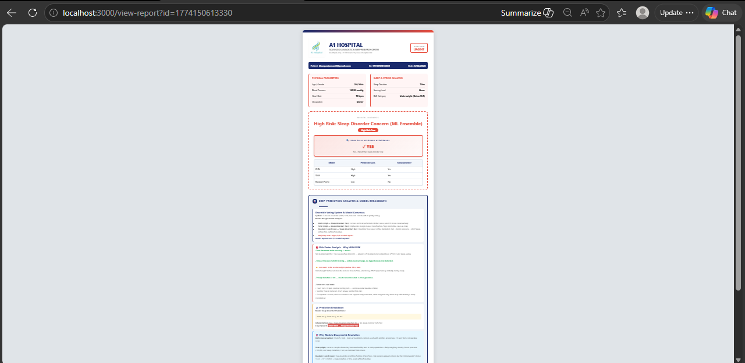

Slide 23
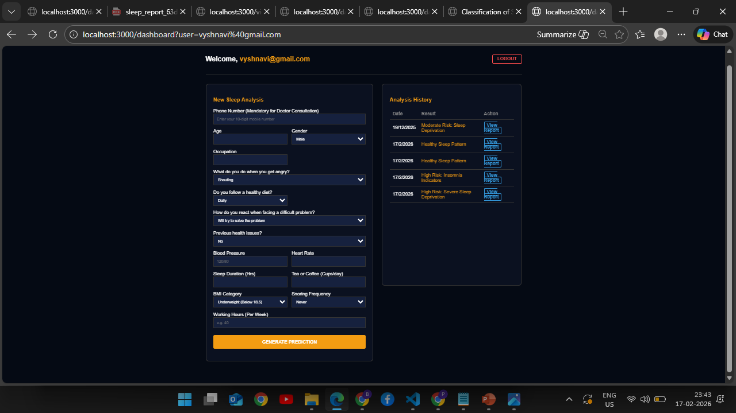

Slide 24


Slide 25
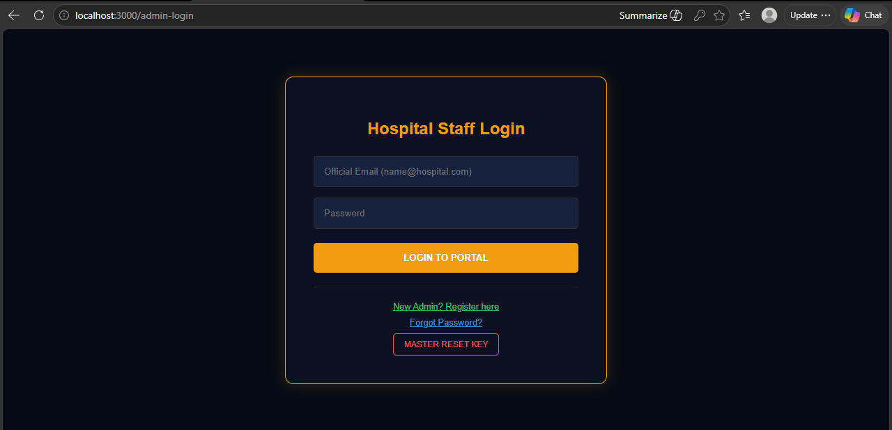

Slide 26
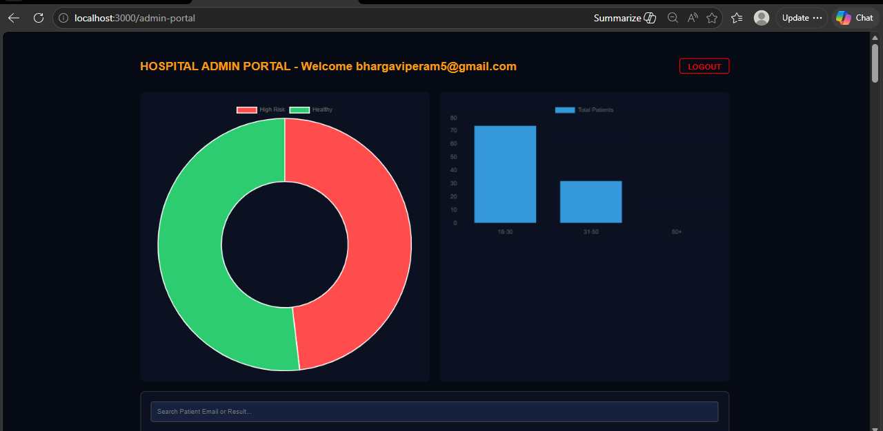

Slide 27
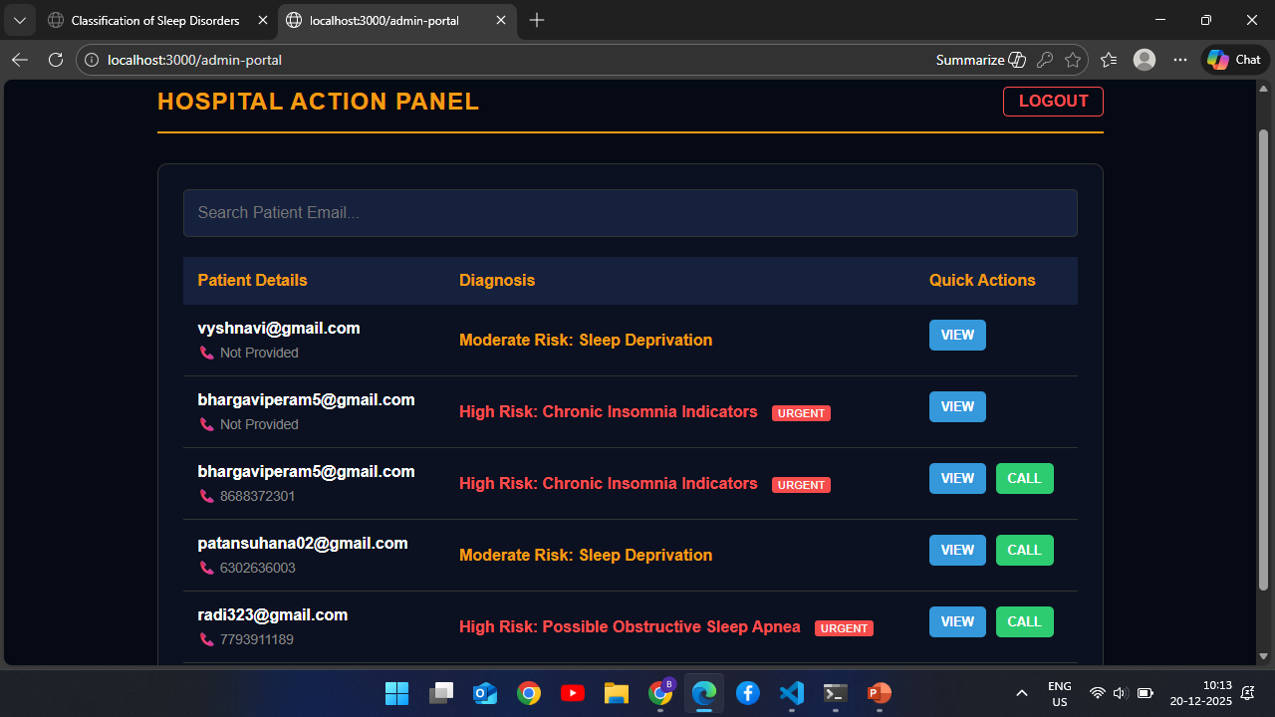

Slide 28
Conclusion
This project develops an efficient system for predicting sleep disorders using an ensemble learning approach that combines multiple machine learning models, such as KNN, SVM, and Random Forest. This project develops an efficient system for predicting sleep disorders using an ensemble learning approach that combines multiple machine learning models such as KNN, SVM and Random Forest. By applying Voting Classifier, the system improves prediction stability and overall reliability compared to individual models. This project develops an efficient system for predicting sleep disorders using an ensemble learning approach that combines multiple machine learning models such as KNN, SVM and Random Forest. By applying Voting Classifier, the system improves prediction stability and overall reliability compared to individual models. Additionally, the system has been extended into a mobile application to enhance accessibility, real-time monitoring, user engagement, and personalized health tracking, making the solution more practical and user-friendly in real-world scenarios.

Slide 29
References
[1] Zhang, J., Zhang, W., & Hu, Y. (2021). Automatic Sleep Stage Classification Based on Time-Frequency Images of Single-Channel EEG Signals. IEEE Transactions on Neural Systems and Rehabilitation Engineering, 29, 1234-1244.
[2 Wang, Y., Li, J., & Zhang, X. (2020). Sleep Disorder Detection and Classification Using Multimodal Physiological Signals. IEEE Journal of Biomedical and Health.
[3] Zhao, H. Y., Liu, Y. X., & Li, S. Q. (2019). An Improved Random Forest Algorithm for Sleep Disorder Classification. BioMed Research International, 2019.
[4] Park, S. H., Kim, S. W., & Lee, J. M. (2020). Application of Deep Learning Algorithms in Sleep Disorder Classification Using Polysomnographic Data. Journal of Sleep Research, 29(4), e12839.
[5] Alves, L. L., Vieira, M. A., & De Oliveira, J. R. F. (2019). Machine Learning Techniques for Sleep Disorder Diagnosis. Procedia Computer Science, 162, 423-430.

Slide 30


